Slide 1

Weekly Report
Tianyu Wang
August 18,2021

Slide 2
Review of Last Meeting
Completed:
Do the data cleaning from the view of mark down language.
2. Collect message except natural language in pull request.（part of）
To do:
Collect message except natural language in pull request.
Do the preprocessing

Slide 3

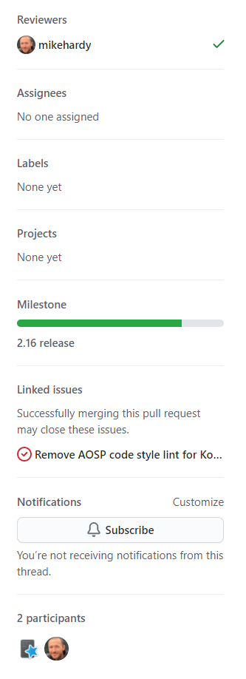
Collection of pull request
Basic information of pull request:
User
Created_at
Updated_at
Merged_at
Closed_at
Reviewers
Assignees
Labels
Pojects
Milestone
Title
Description
Creator
Created_at
State

Slide 4
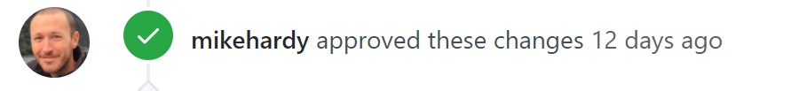
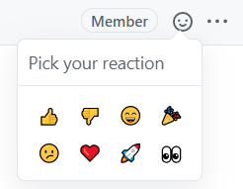
Conversation in pull request
User
Created_at
author_association
State('APPROVED', 'CHANGES_REQUESTED', 'COMMENTED', 'DISMISSED’)
Issues_event
Timeline_event
Reactions

Slide 5
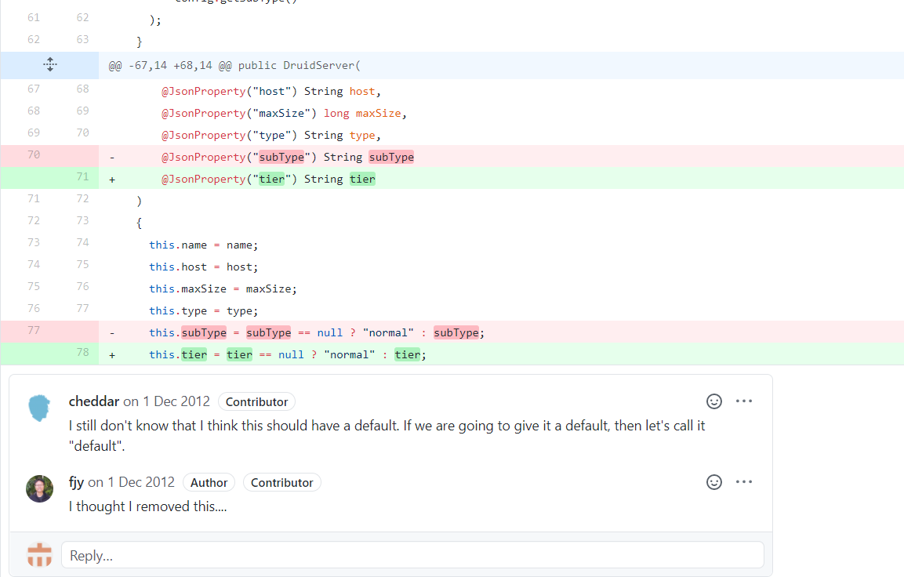
Commits in pull request
User
Created_at
Author_association
Commit_id
Position
Line
Path
position

Slide 6
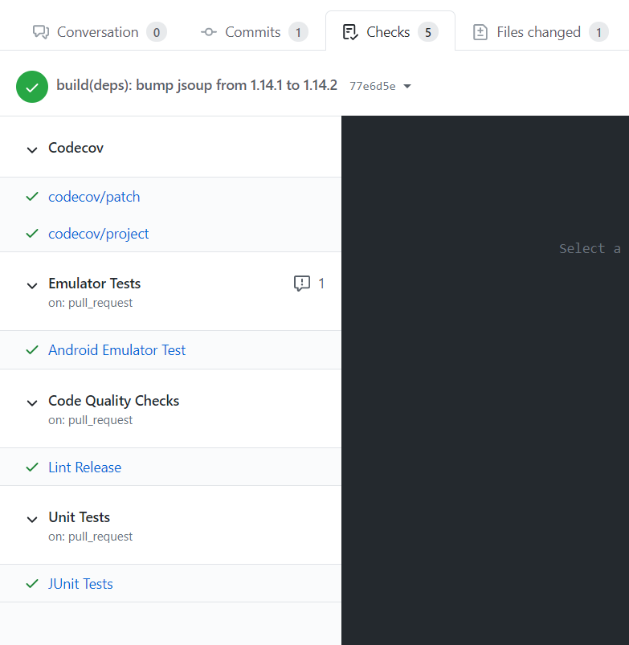
Checks in pull request

Slide 7
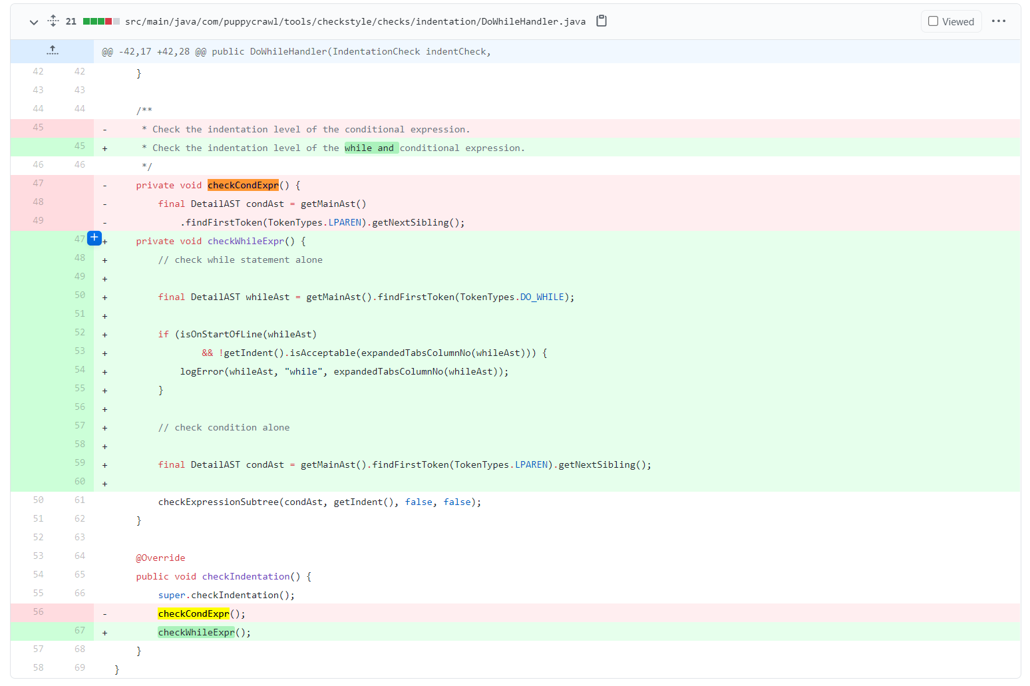
File change in pull request
File_name
status
Additions
Commit_id
deletions
changes
patch

Slide 8
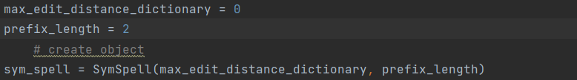
Preprocessing
Remove stopwords(1%most common words)
Remove none English words
Remove numbers
Remove punctuation
Lemmatization
Spelling check

